Slide 1
Overfitting issue in machine learning
Student : Đinh Hồng Hà – 518H0171
Instructor : PGS Lê Anh Cường
Group 21

Slide 2
What is Overfitting in Machine Learning?

Slide 3
Overfitting
Statistical model is said to be overfitted, when we train it with a lot of data.
When a model gets trained with so much of data, it starts learning from the noise and inaccurate data entries in our data set or we have not supplied enough data. Then the model does not categorize the data correctly, because of too many details and noise. Meanwhile, it negatively affects the accuracy of the general model.
The models that have been over-fit on the training data do not generalise well to new examples. They are not good at predicting unseen data.

Slide 4
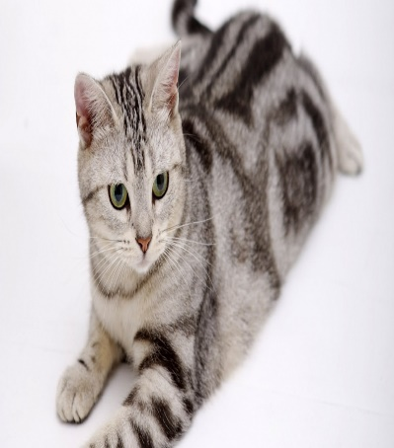



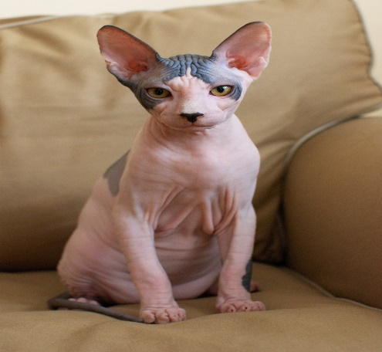

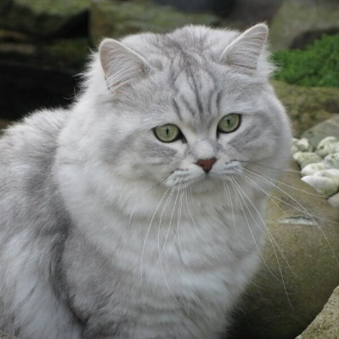
Overfitting
Data training
Data test

Slide 5
Overfitting
With this cat, the model will predict it to be a cat because it has the same characteristics as the training data such as fur, skin ...
So it is correct in this case

Slide 6
Overfitting
With this cat, the model will predict it is not a cat because it has different characteristics with training data such as fur, skin ...
So it is correct in this case

Slide 7

Overfitting
With this cat, the model will also predict it is not a cat because it has different characteristics with training data such as fur, skin ...
However, it is wrong in this case

Slide 8
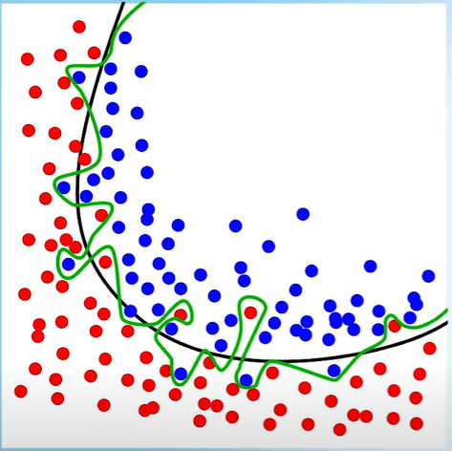
Overfitting
In this graph, we have two dots, red and blue.
We have two lines, green line and black line.
The green line always follow to the data training data so it never wrong. If we have a dog which is not belong data training, it may be wrong.
The black line is general, so it will better.
So Overfitting is when our model fails to generalize well.

Slide 9
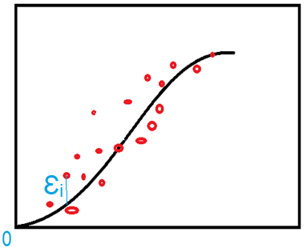
How to detect Overfitting
Error squared is substantially lower during training of the model and the accuracy deteriorates on the test data set
(Ɛ₁)² + (Ɛ₂)² + (Ɛ₃)² + …+ (Ɛ_{n})² very small => Overfitting

Slide 10
How to resolve Overfitting
Reduce Features
Model Selection Algorithms
Regularization:
The aim of regularization is to keep all of the features but impose a constraint on the magnitude of the coefficients.
LASSO
RIDGE
- Solution 1 and 2 have problem is we might end up losing
valuable information so solution 3 is better

Slide 11
Thank you

